Slide 1
UNIX

Slide 2

CONTENTS
UNIX OVERVIEW
MANAGING FILESYSTEM
FILE HANDLING
MANAGING PROCESSES
For Internal Use Only

Slide 3
UNIX OVERVIEW
Notes:
UNIX is an operating system which was first developed in the 1960s, and has been under constant development ever since. By operating system, we mean the suite of programs which make the computer work. It is a stable, multi-user, multi-tasking system for servers, desktops and laptops.
*Linux is a Unix-clone
Linux is a Unix clone written from scratch by Linus Torvalds with assistance from a loosely-knit team of hackers across the Net. It aims towards POSIX compliance.

Slide 4
UNIX ARCHITECTURE
KERNEL
Key or core component of the operating system which has complete control over everything that occurs in the system.
SHELLS (CLI & GUI)
User interfaces for access to the operating system’s services, depending on a computer’s role and particular operation.
SYSTEM UTILITIES
System software which allow users to perform specific task related to managing a computer, its devices, or its programs.
APPLICATION PROGRAMS
Programs that allow users to perform different tasks or activities for the benefit of the user.
Notes:
Kernel − The kernel is the heart of the operating system. It interacts with the hardware and most of the tasks like memory management, task scheduling and file management.
Shell − The shell is the utility that processes your requests. When you type in a command at your terminal, the shell interprets the command and calls the program that you want. The shell uses standard syntax for all commands. C Shell, Bourne Shell and Korn Shell are the most famous shells which are available with most of the Unix variants.
Commands and Utilities − There are various commands and utilities which you can make use of in your day to day activities.
cp, mv, cat and grep, etc. are few examples of commands and utilities. There are over 250 standard commands plus numerous others provided through 3rd party software. All the commands come along with various options.
Files and Directories − All the data of Unix is organized into files. All files are then organized into directories. These directories are further organized into a tree-like structure called the filesystem.

Slide 5
FLAVORS OF UNIX
Linux
Solaris
SunOS
Minix
NetBSD
LynxOS
SuSE
UnixWare
For Internal Use Only
Notes:
Unix – Solaris, SunOS, HP-UX, IBM AIX, Mac OS X
Linux – RedHat Enterprise, Fedora, Debian, Suse, Ubuntu

Slide 6
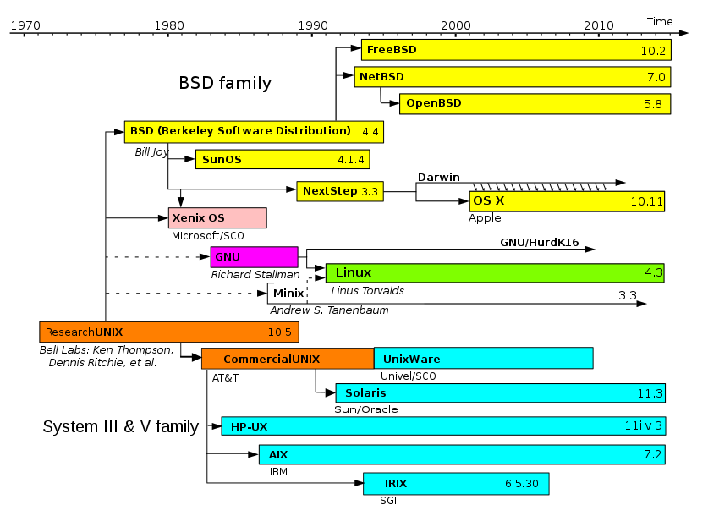
FLAVORS OF UNIX
For Internal Use Only
Notes:
Unix – Solaris, SunOS, HP-UX, IBM AIX, Mac OS X
Linux – RedHat Enterprise, Fedora, Debian, Suse, Ubuntu

Slide 7
LOGGING INTO & OUT OF UNIX SYSTEMS
Text-based (TTY) Terminals
When you log in locally using a terminal, you will see the prompt:
login:
At this prompt, type in your username and press the Enter key. You should then be prompted for your password:
login: <username>
password:
Type your password in at the prompt and press the Enter key. Note that your password will not be displayed as you type it in.
To log out, type exit at the shell prompt. If it doesn’t work, try logout or press Ctrl + D.
Graphical Terminals
You will be presented with a graphical prompt with login and password fields. Enter your user name and password in the same way as Test-based Terminals, although you may need to press the Tab key to move between fields.
Notes:
TTY – teletype

Slide 8
USER MANAGEMENT
There are four types of account on a Unix system:
Root Account
System Accounts
User Accounts
Group Accounts
Notes:
Root account: This is also called superuser and would have complete and unfettered control of the system. A superuser can run any commands without any restriction. This user should be assumed as a system administrator.
System accounts: System accounts are those needed for the operation of system-specific components for example mail accounts and the sshd accounts. These accounts are usually needed for some specific function on your system, and any modifications to them could adversely affect the system.
User accounts: User accounts provide interactive access to the system for users and groups of users. General users are typically assigned to these accounts and usually have limited access to critical system files and directories.
Group Accounts: Group numbers of accounts. Every account would be a part of any group account. Unix groups plays an important role in handling file permissions and process management

Slide 9
MANAGING FILESYSTEM

Slide 10
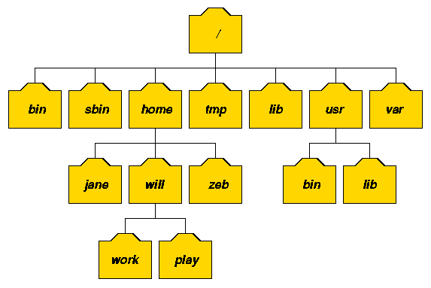
UNIX DIRECTORY STRUCTURE
The UNIX filesystem is laid out as a hierarchical tree structure which is anchored at a special top-level directory known as the root (designated by a slash '/')..
The figure above illustrates this layout.
Notes:
Because of the tree structure, a directory can have many child directories, but only one parent directory

Slide 11

UNIX DIRECTORY STRUCTURE
To specify a location in the directory hierarchy, we must specify a path through the tree. The path to a location can be defined by an absolute path from the root /, or as a relative path from the current working directory.
To specify a path, each directory along the route from the source to the destination must be included in the path, with each directory in the sequence being separated by a slash.
Ex.
Notes:
To help with the specification of relative paths, UNIX provides the shorthand "." for the current directory and ".." for the parent directory. For example, the absolute path to the directory "play" is /home/will/play, while the relative path to this directory from "zeb" is ../will/play

Slide 12
UNIX DIRECTORY STRUCTURE
DIRECTORY | TYPICAL CONTENTS
/ | The "root" directory.
/bin | Essential low-level system utilities.
/usr/bin | Higher-level system utilities and application programs.
/sbin | Superuser system utilities (for performing system administration tasks).
/lib | Program libraries (collections of system calls that can be included in programs by a compiler) for low-level system utilities.
/usr/lib | Program libraries for higher-level user programs.
/tmp | Temporary file storage space (can be used by any user).
/home or /homes | User home directories containing personal file space for each user. Each directory is named after the login of the user.
/etc | UNIX system configuration and information files.
/dev | Hardware devices.
/proc | A pseudo-filesystem which is used as an interface to the kernel. Includes a sub-directory for each active program (or process).

Slide 13
DIRECTORY & FILE HANDLING COMMANDS
COMMANDS | DESCRIPTION
pwd | Displays the full absolute path to your current location in the filesystem.
ls | Lists the contents of a directory.
cd <path> | Changes your current working directory to the path you set.
mkdir <directory> | Creates a subdirectory in the current working directory.
rmdir <directory> | Removes the subdirectory from the current working directory.
cp <sourcefile> <destination> | Used to make copies of files or entire directories.
mv <source> <destination> | Used to rename files or directories and / or move them from one directory to another.
rm <targetfile> | Removes the specified file.
cat <targetfile> | Displays the content of the specified file.
more <targetfile> | Displays the contents of the specific file, pausing at the end of the screen and asking the user to press a key (for long files).
less <targetfile> | Just like more. Also allows users to scroll backward and forward through the displayed file.
Notes:
For demo

Slide 14
HARD & SOFT LINKS
A hard link allows a user to create two exact files without having to duplicate the data on disk. However unlike creating a copy, if you modify the hard link you are in turn modifying the original file as well as they both reference the same inode.
A soft link is similar to a hard link in that it is used to link to an already existing file, however it is very different in its implementation. A symbolic link is not a reference to an inode but rather an pointer that redirects to another file or directory.
An inode is a data structure used to represent a filesystem object, which can be one of various things including a file or a directory.
Notes:
Similar to shortcuts in Windows:
Hard link is creating another copy of the file
Soft link is just a shortcut to the file (delete the original file, and the soft link will be unusable)

Slide 15
HARD & SOFT LINKS
Hard (direct) and soft (indirect or symbolic) links can be created using the ln command.
$ ln filename linkname
creates another directory entry for filename called linkname (i.e. linkname is a hard link). Both directory entries appear identical (and both now have a link count of 2).
$ ln –s filename linkname
creates a shortcut called linkname (i.e. linkname is a soft link). The shortcut appears as an entry with a special type ('l'):
$ ln –s hello.txt bye.txt
$ ls –l bye.txt
lrwxrwxrwx 1 will finance 13 bye.txt -> hello.txt
Notes:
The link count of the source file remains unaffected. Notice that the permission bits on a symbolic link are not used (always appearing as rwxrwxrwx). Instead the permissions on the link are determined by the permissions on the target (hello.txt in this case).
Useful commands to demo
ls –li to see inodes
Ln –s source destination→ soft link
Ln source destination → hardlink

Slide 16
SPECIFYING MULTIPLE FILENAMES
Multiple filenames can be specified using special pattern-matching characters. The rules are:
'?' matches any single character in that position in the filename.
'*' matches zero or more characters in the filename. A '*' on its own will match all files. '*.*' matches all files with containing a '.'.
Characters enclosed in square brackets ('[' and ']') will match any filename that has one of those characters in that position.
A list of comma separated strings enclosed in curly braces ("{" and "}") will be expanded as a Cartesian product with the surrounding characters.

Slide 17
SPECIFYING MULTIPLE FILENAMES
For example:
??? matches all three-character filenames.
?ell? matches any five-character filenames with 'ell' in the middle.
he* matches any filename beginning with 'he'.
[m-z]*[a-l] matches any filename that begins with a letter from 'm' to 'z' and ends in a letter from 'a' to 'l'.
{/usr,}{/bin,/lib}/file expands to /usr/bin/file, /usr/lib/file, /bin/file and /lib/file.
Notes:
ls {/home,}{/vagrant,}/file1

Slide 18
FILE HANDLING

Slide 19
File and Directory Permissions
File ownership is an important component of UNIX that provides a secure method for storing files.
UNIX file attributes:
(u) Owner Permissions
(g) Group Permissions
(o) Other Permissions
Notes:
Owner permissions − The owner's permissions determine what actions the owner of the file can perform on the file.
Group permissions − The group's permissions determine what actions a user, who is a member of the group that a file belongs to, can perform on the file.
Other (world) permissions − The permissions for others indicate what action all other users can perform on the file.

Slide 20
File and Directory Permissions(Cont’d)
File and Directory Permissions
Permission | File | Directory
Read (r) | User can look at the contents of the file | User can list the files in the directory
Write (w) | User can modify the contents of the file | User can create new files and remove existing files in the directory
Execute (x) | User can use the filename as a UNIX command | User can change into the directory, but cannot list the files unless (s)he has read permission. User can read files if (s)he has read permission on them.

Slide 21
File and Directory Permissions(Cont’d)
Permission Indicators
r - | read
w - | write
x - | execute
-rwx
r-x
x--
(2-4) Owner Permissions
U
(8-10) Other Permissions
O
(5-7) Group Permissions
G

Slide 22
File and Directory Permissions(Cont’d)
Changing Permissions
To change file or directory permissions, you use the chmod (change mode) command.
2 Ways to change permissions:
Symbolic Mode
Absolute Permission
Format:
$ chmod options files

Slide 23
File and Directory Permissions(Cont’d)
Symbolic Mode
Using chmod in
Chmod operator | Description
+ | Adds the designated permission(s) to a file or directory.
- | Removes the designated permission(s) from a file or directory.
= | Sets the designated permission(s).
Ex.
$ chmod o+wx README.txt

Slide 24
File and Directory Permissions(Cont’d)
Using chmod with Absolute Permissions
Number | Octal Permission Representation | Ref
0 | No permission | ---
1 | Execute permission | --x
2 | Write permission | -w-
3 | Execute and write permission: 1 (execute) + 2 (write) = 3 | -wx
4 | Read permission | r--
5 | Read and execute permission: 4 (read) + 1 (execute) = 5 | r-x
6 | Read and write permission: 4 (read) + 2 (write) = 6 | rw-
7 | All permissions: 4 (read) + 2 (write) + 1 (execute) = 7 | rwx

Slide 25
File and Directory Permissions(Cont’d)
Using chmod with Absolute Permissions (Cont’d)
Ex.
$ chmod 755 README.txt
U G O
rwx rwx rwx
4-2-1 4-2-1 4-2-1
111 101 101
7 5 5

Slide 26
Finding files
Finding Files
There are at least three ways to find files when you don't know their exact location. Use the following commands:
Find command
Which command
Locate command

Slide 27
Finding files (Cont’d)
Find command
Format:
$ find (starting directory) (matching criteria and actions)
Ex.
$ find /home –name tecmint.txt
This example will find all the files under /home directory with name tecmint.txt.
Notes:
If you have a rough idea of the directory tree the file might be in (or even if you don't and you're prepared to wait a while) you can use find command

Slide 28
Finding files (Cont’d)
Which command
Format:
$ which command OR which [options] command OR which program
Ex.
$ which date
This example will find the executable file associated with a command name of date.
Notes:
The which command shows the full path for each of its given arguments. This command searchers for an executable or script in the user’s PATH.

Slide 29
Finding files (Cont’d)
Locate command
Format:
$ locate string
Ex.
$ locate “.txt”
This example will find all filenames in the filesystem that contain “.txt” anywhere in their full paths.
Notes:
find command can take a long time to execute if you are searching a large filespace (e.g. searching from / downwards). The locate command provides a much faster way of locating all files whose names match a particular search string.
*In centos7 run:
Sudo yum install mlocate –y
Updatedb
Then run the command.

Slide 30
Finding text in files using grep, sed and awk
Grep command
Format:
$ grep options pattern files
Ex.
$ grep hello *.txt
This example searches all text files in the current directory for lines containing "hello“
Notes:
The grep command searches the given input files for lines containing a match to the given PATTERN.
By default, grep prints the matching lines. It has no limits on input line length other than available memory, and it can match arbitrary characters within a line

Slide 31
Finding text in files using grep, sed and awk
Sed command
Format:
$ sed options [script] [input_file]
Ex.
$ sed ‘s/Nick/John/g’ report.txt
This example will replace every occurrence of Nick with John in report.txt
Notes:
sed, short for "stream editor", allows you to filter and transform text.
A stream editor is used to perform basic text transformations on an input stream (a file, or input from a pipeline). While in some ways similar to an editor which permits scripted edits (such as ed), sed works by making only one pass over the input(s), and is consequently more efficient. But it is sed's ability to filter text in a pipeline which particularly distinguishes it from other types of editors.

Slide 32
Finding text in files using grep, sed and awk
Awk command
Format:
$ awk ‘/search pattern1/ {actions} /search pattern2/ {actions}’ file
Ex.
$ awk ‘/Thomas/ > /Nisha/’ employee.txt
This example prints all the line which matches with the ‘Thomas’ or ‘Nisha’.
Notes:
The awk command is mostly used for pattern scanning and processing.
It searches one or more files to see if they contain lines that matches with the specified patterns and then perform associated actions.

Slide 33
Sorting Files
There are two facilities that are useful for sorting files in UNIX:
Sort command
Uniq command

Slide 34
Sorting Files (Cont’d)
Sort command
Format:
$ sort filename
Ex.
$ sort names.txt
This example sorts file in ascending order.
Notes:
The sort command sorts the contents of a file, in numeric or alphabetic order, and prints the results to standard output (usually the terminal screen)

Slide 35
Sorting Files (Cont’d)
Uniq command
Format:
$ uniq filename
Ex.
$ uniq names.txt
This example removes duplicate adjacent lines in the file.
Notes:
uniq command reports or filters out repeated lines in a file.
uniq command filters out adjacent, matching lines from input file INPUT, writing the filtered data to output file OUTPUT.
This facility is most useful when combined with sort

Slide 36
File Compression and Backup
UNIX systems usually support a number of utilities for backing up and compressing files.
Some of them are:
Tar command
Gzip command
Compress command

Slide 37
File Compression and Backup (Cont’d)
Tar command (tape archiver)
Format:
$ tar options archive_name
Ex.
$ tar -cvf an_archive file1 file2
Where an_archive will have the .tar extension.
Here c option means create, v means verbose (output filenames as they are archived), and f means file.
Notes:
Tar command backs up entire directories and files onto a tape device or (more commonly) into a single disk file known as an archive.
An archive is a file that contains other files plus information about them, such as their filename, owner, timestamps, and access permissions.
Tar does not perform any compression by default.
Untar: tar -xvf other

Slide 38
File Compression and Backup (Cont’d)
Gzip command
Format:
$ gzip options filename
Ex.
$ gzip README.txt
This example will create README.gz and will delete README.txt
Notes:
Gzip command compresses files. Each single file is compressed into a single file. The compressed file consists of a GNU zip header and deflated data. It can also be used to decompress files.
If given a file as an argument, gzip compresses the file, adds a ".gz" suffix, and deletes the original file. With no arguments, gzip compresses the standard input and writes the compressed file to standard output.
When you decompress the.gz file, it will return the original file and .gz file will be deleted

Slide 39
File Compression and Backup (Cont’d)
Compress command
Format:
$ compress options filename
Ex.
$ compress README.txt
This example will create README.z and will delete README.txt
Notes:
Compress command also functions like the gzip command. The only difference is that its file extension name will be “.z” instead of .gz.

Slide 40
Managing Processes

Slide 41
Processes
A process is a program in execution. Whenever you issue a command in UNIX, it creates, or starts, a new process.
There are two ways to start a process (run a command)
Foreground Processes
Background Processes
Notes:
While a program is running in foreground, we cannot run any other commands (start any other processes) because prompt would not be available until the program finishes its processing. There can be only one job in the foreground at any time. The foreground job has control of the shell with which you interact - it receives input from the keyboard and sends output to the screen
Processes in the background do not receive input from the terminal, generally running along quietly without the need for interaction (and drawing it to your attention if they do).

Slide 42
Processes (Cont’d)
Sample Foreground Process
$ ls ch* .doc
This would display all the files whose name start with ch and ends with .doc.
ch01-1.doc ch010.doc ch02.doc ch03-2.doc ch04-1.doc ch040.doc ch05.doc ch06-2.doc ch01-2.doc ch02-1.doc
In this example, the process runs in the foreground, the output is directed to the screen, and if the ls command wants any input (which it does not), it waits for it from the keyboard. In this process, we cannot run any other command while this one is not yet finished.

Slide 43
Processes (Cont’d)
Sample Background Process
The simplest way to start a background process is to add an ampersand
(&) at the end of the command.
$ ls ch* .doc &
This would also display all the files whose name start with ch and ends with .doc
ch01-1.doc ch010.doc ch02.doc ch03-2.doc ch04-1.doc ch040.doc ch05.doc ch06-2.doc ch01-2.doc ch02-1.doc
Here if the ls command wants any input (which it does not), it goes into a stop state until it is moved into the foreground and give it the data from the keyboard.

Slide 44
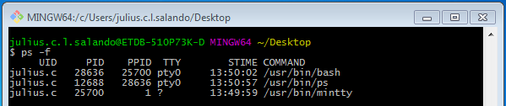
Processes (Cont’d)
Listing Running Processes
You can see the running processes by using the ps command (process status).
Column | Description
UID | User ID that this process belongs to (the person running it).
PID | Process ID.
PPID | Parent process ID (the ID of the process that started it).
STIME | Process start time.
TTY | Terminal type associated with the process
CMD | The command that started this process.
Notes:
Command: Ps -f

Slide 45
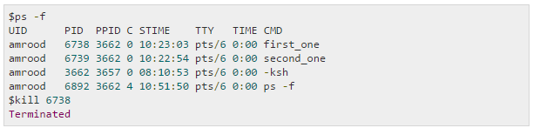
Processes (Cont’d)
Stopping Running Processes
If the process is running in foreground mode…
use CTR + C keystroke.
However, if the process is running in background mode. First you need to get its PID then use the kill command to terminate the process.
Notes:
Command:
Kill PID

Slide 46
Pipes
The pipe ('|') operator is used to create concurrently executing processes that pass data directly to one another. It is useful for combining system utilities to perform more complex functions. For example:
Ex.
$ cat hello.txt | sort | uniq
This example creates three processes (corresponding to cat, sort and uniq) which execute concurrently.
As they execute, the output of the who process is passed on to the sort process which is in turn passed on to the uniq process.
uniq displays its output on the screen (a sorted list of users with duplicate lines removed).

Slide 47
Useful commands
cd | Change directory Ex. cd .. to go back to once cd ../.. to go back twice cd <directory> to go to a directory
pwd | Print working directory – returns the path
Ls | List contents

